Slide 1




Slide 2
Fine-tuning a Question-Answering system
Notes:
Hello and welcome, in this video we will start to dive into the components of the internal structure of transformers.

Slide 3
In this video
Explore the step-by-step process of fine-tuning:
Retriever model
Reader model.

Slide 4
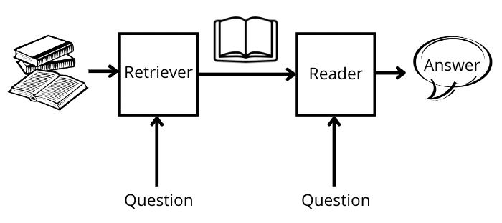
Advanced QA system
The retriever: search through many documents or knowledge sources to identify relevant passages for a given question.
The reader: typically, a deep learning model, extracts the answer from the retrieved passages.

Slide 5
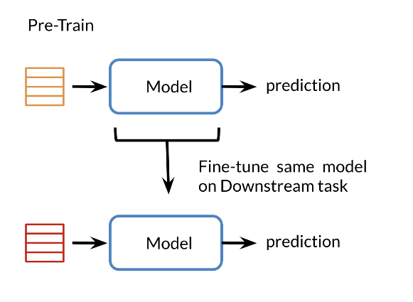
What’s Fine-tuning?
Fine-tuning: The process of adapting a pre-trained model to a specific domain or task by further training it on domain-specific data.
Fine-tuning benefits:
Helps the models understand the context and nuances of a particular domain → more accurate answers.
Allows the system to leverage domain-specific knowledge and improves its performance when dealing with domain-specific queries.

Slide 6
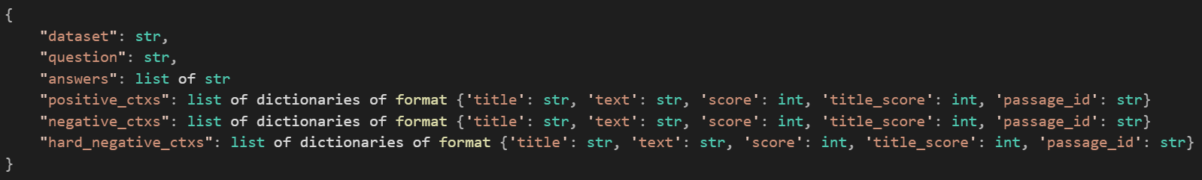
Fine-tune the retriever
The retriever → searches and retrieves relevant passages.
Fine-tune the retriever using the Haystack framework:
Prepare the dataset:
need a labeled DPR training dataset that matches your retrieval task (pairs of queries and relevant documents).
Train a model:
The dataset needs to be in the same format as the original DPR training data.
Positive_ctxs are context passages which are relevant to the query.

Slide 7
Fine-tune the retriever
The retriever → searches and retrieves relevant passages.
Fine-tune the retriever using the Haystack framework:
Prepare the dataset:
need a labeled DPR training dataset that matches your retrieval task (pairs of queries and relevant documents).
Train a model:
The dataset needs to be in the same format as the original DPR training data.
Positive_ctxs → context passages that are relevant to the query.
negative_ctxs → not used in Haystack's DPR training so we recommend you set it to an empty list.

Slide 8
Fine-tune the retriever
The retriever → searches and retrieves relevant passages.
Fine-tune the retriever using the Haystack framework:
Prepare the dataset:
need a labeled DPR training dataset that matches your retrieval task (pairs of queries and relevant documents).
Train a model:
The dataset needs to be in the same format as the original DPR training data.
Positive_ctxs → context passages that are relevant to the query.
negative_ctxs → not used in Haystack's DPR training so we recommend you set it to an empty list.
hard_negative_ctxs are passages that are not relevant to the query → which contain the answer text are filtered out.

Slide 9
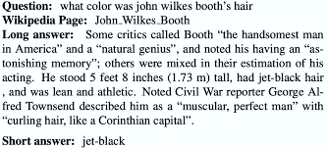
Fine-tune the retriever
Google's Natural Questions dataset: Sufficiently large and contains enough unique passages.
DPR training set → Considering answers containing passages as relevant documents to the query.
Note:
The SQuAD dataset → is not as suited to this use case since its question-and-answer pairs are created on only a very small slice of Wikipedia documents

Slide 10
1. Download the dataset
Download the original DPR training data:
Note: that Google's Natural Questions dataset data is probably only useful if you are trying to train from scratch.
doc_dir = "data/tutorial9“
s3_url_train = "https://dl.fbaipublicfiles.com/dpr/data/retriever/biencoder-nq-train.json.gz"
s3_url_dev = "https://dl.fbaipublicfiles.com/dpr/data/retriever/biencoder-nq-dev.json.gz"
fetch_archive_from_http(s3_url_train, output_dir=doc_dir + "/train")
fetch_archive_from_http(s3_url_dev, output_dir=doc_dir + "/dev")

Slide 11
2. Initialize The model
1. Using BERT base:
The model is trained using Google's Natural Questions dataset in a format specialized for DPR.
2. For domain-specific dataset:
Initialize both query and passage models using the original pre-trained model from Facebook.
train_filename = "train/biencoder-nq-train.json"
dev_filename = "dev/biencoder-nq-dev.json"
query_model = "bert-base-uncased"
passage_model = "bert-base-uncased"
save_dir = "../saved_models/dpr"
doc_dir = "PATH_TO_YOUR_DATA_DIR"
train_filename = "TRAIN_FILENAME"
dev_filename = "DEV_FILENAME"
query_model = "facebook/dpr-question_encoder-single-nq-base"
passage_model = "facebook/dpr-ctx_encoder-single-nq-base"
save_dir = "../saved_models/dpr"

Slide 12
2. Initialize The model
1. Using BERT base:
The model is trained using Google's Natural Questions dataset in a format specialized for DPR.
2. For domain-specific dataset:
Initialize both query and passage models using the original pre-trained model from Facebook.
train_filename = "train/biencoder-nq-train.json"
dev_filename = "dev/biencoder-nq-dev.json"
query_model = "bert-base-uncased"
passage_model = "bert-base-uncased"
save_dir = "../saved_models/dpr"
doc_dir = "PATH_TO_YOUR_DATA_DIR"
train_filename = "TRAIN_FILENAME"
dev_filename = "DEV_FILENAME"
query_model = "facebook/dpr-question_encoder-single-nq-base"
passage_model = "facebook/dpr-ctx_encoder-single-nq-base"
save_dir = "../saved_models/dpr"

Slide 13
3. Initialize DPR model
from haystack.nodes import DensePassageRetriever
from haystack.document_stores import InMemoryDocumentStore
retriever = DensePassageRetriever(
document_store=InMemoryDocumentStore(),
query_embedding_model=query_model,
passage_embedding_model=passage_model,
max_seq_len_query=64,
max_seq_len_passage=256,
)

Slide 14
4. Start model training
retriever.train(
data_dir=doc_dir,
train_filename=train_filename,
dev_filename=dev_filename,
test_filename=dev_filename,
n_epochs=1,
batch_size=16,
grad_acc_steps=8,
save_dir=save_dir,
evaluate_every=3000,
embed_title=True,
num_positives=1,
num_hard_negatives=1,
)
When embed_title=True, the document title is prepended to the input text sequence with a (SEP) token between it and the document text.
5. Load retrieval model
reloaded_retriever = DensePassageRetriever.load(load_dir=save_dir, document_store=None)

Slide 15
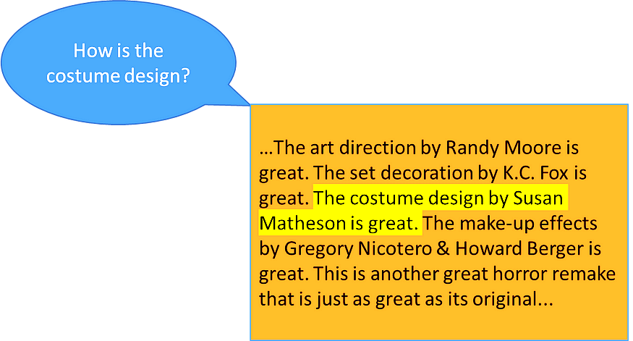
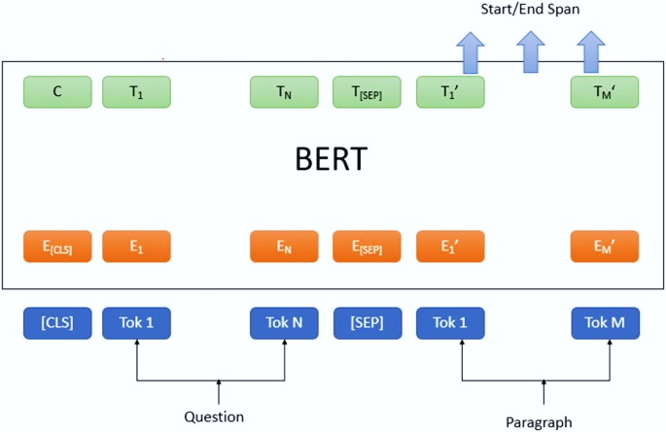
Fine-tune the reader
The reader → understands the retrieved passages and extracts the most accurate answer to the given question.
Fine-tune the transformer model to a QA task:
Load a dataset for these kinds of tasks.
Use the Trainer API to fine-tune a model on it.

Slide 16
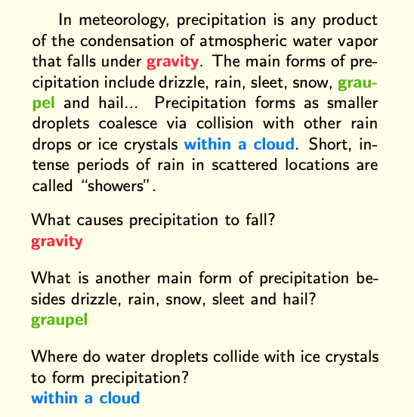
Fine-tune the reader
Using the SQUAD dataset.
Note: The same codes should work with any QA dataset provided by the hugging face Datasets library.
Note: If you're using your dataset defined from a JSON or CSV → it might need some adjustments in the names of the columns used.
Any QA dataset should have 3 main features → the question, the context, and the answer.

Slide 17
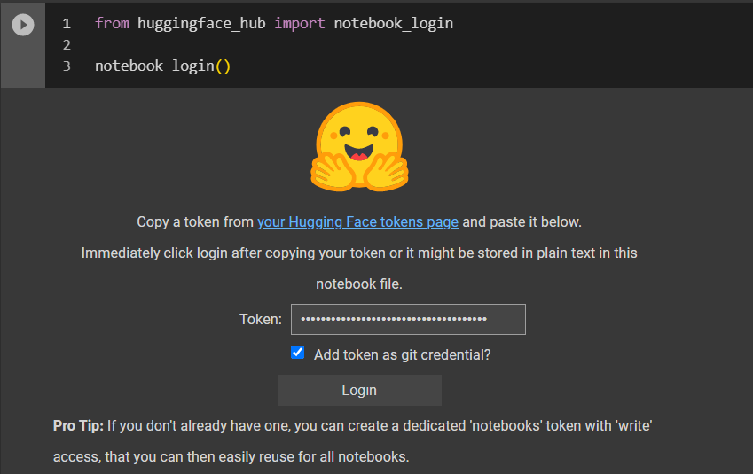
Fine-tune the reader
install the transformers and datasets libraries:
Login to hugging face account with read access token:
Use Bert base uncased pretrained model as checkpoint:
! pip install datasets transformers
model_checkpoint = "bert-base-uncased"
batch_size = 16

Slide 18
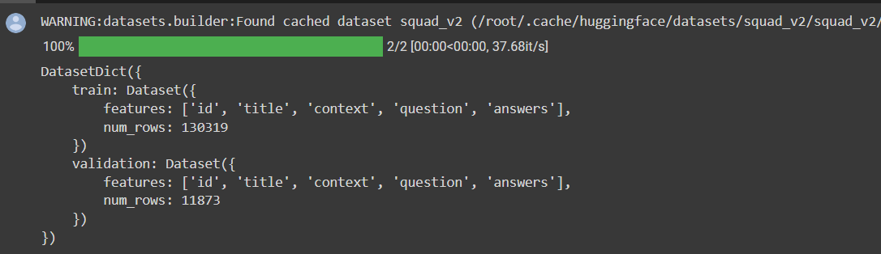
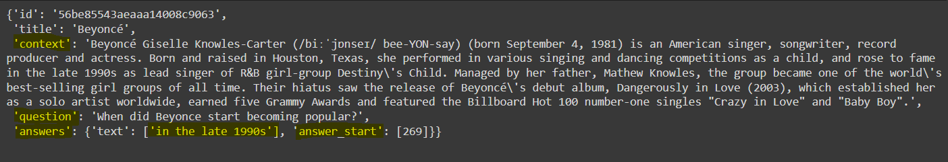
Fine-tune the reader
4. Download the data using the hugging face Datasets library:
The training, validation and test sets all have a column for the context, the question and the answers.
To access an actual element:
from datasets import load_dataset
datasets = load_dataset("squad_v2")
datasets
datasets["train"][0]

Slide 19
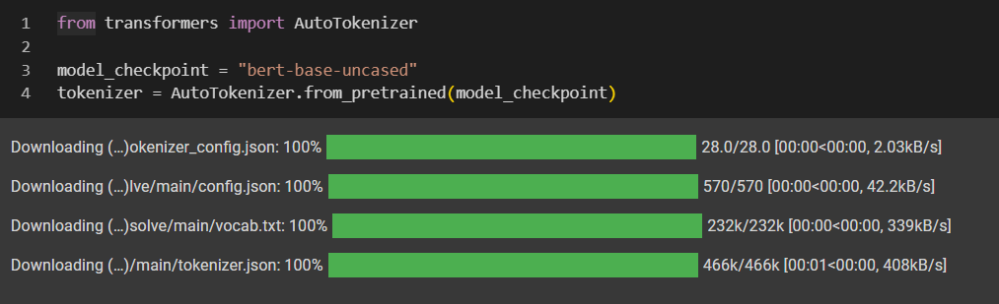
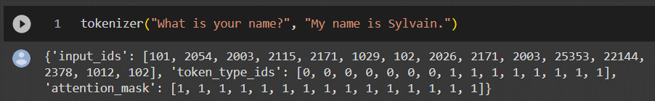
Preprocessing the training data
Transformers Tokenizer: tokenize the inputs including converting the tokens to their corresponding IDs.
5. Instantiate our tokenizer:
Download the vocabulary used when pretraining this specific checkpoint.
That vocabulary will be cached.
Test Tokenizer:

Slide 20
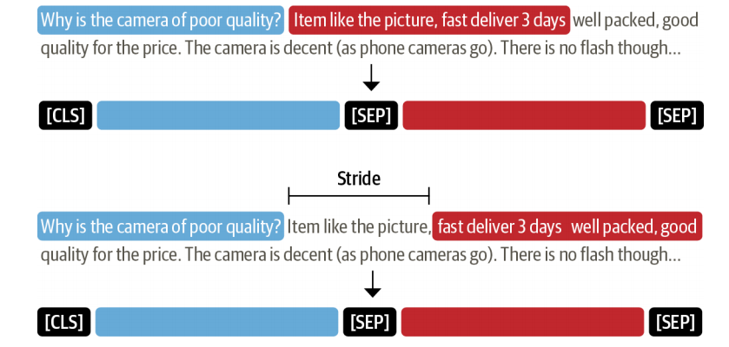
Preprocessing the training data (Long documents)
Truncate when they are longer than the model maximum sentence length.
Removing part of the context might result in losing the answer we are looking for.
Apply a sliding window across the inputs, where each window contains a passage of tokens that fit in the model’s context.

Slide 21
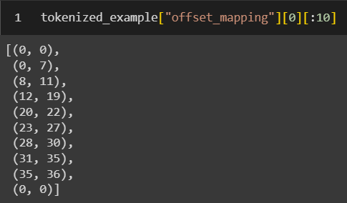
Preprocessing the training data: Tokenization
5. Initialize tokenizer:
Note: we truncate only the context.
The tokenizer can automatically return us a list of features capped by a certain maximum length, with the overlap.
The answer features:
The models we will use require the start and end positions of these answers in the tokens.
so we will also need to map parts of the original context to some tokens.
The tokenizer are using can help us with that by returning an offset_mapping.
tokenized_example = tokenizer(
example["question"],
example["context"],
max_length=max_length,
truncation="only_second",
return_overflowing_tokens=True,
stride=doc_stride
)

Slide 22
Preprocessing the training data: Tokenization
5. Initialize tokenizer:
Note: we truncate only the context.
The tokenizer can automatically return us a list of features capped by a certain maximum length, with the overlap.
The answer features:
The models we will use require the start and end positions of these answers in the tokens.
so we will also need to map parts of the original context to some tokens.
The tokenizer are using can help us with that by returning an offset_mapping.
tokenized_example = tokenizer(
example["question"],
example["context"],
max_length=max_length,
truncation="only_second",
return_overflowing_tokens=True,
stride=doc_stride
)

Slide 23
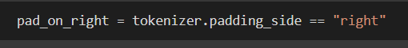
Preprocessing the training data: Tokenization
To account for the special case where the model expects padding on the left:
Putting everything together in one function we will apply to our training set.
you will find the function in the attached notebook with the name of prepare_training_features.

Slide 24

Preprocessing the training data: Tokenization
Apply prepare_train_features function on pairs of sentences in our dataset:
Encode the texts by batches together → leverage the full benefit of the fast tokenizer we loaded earlier, which will use multi-threading to treat the texts in a batch concurrently.

Slide 25
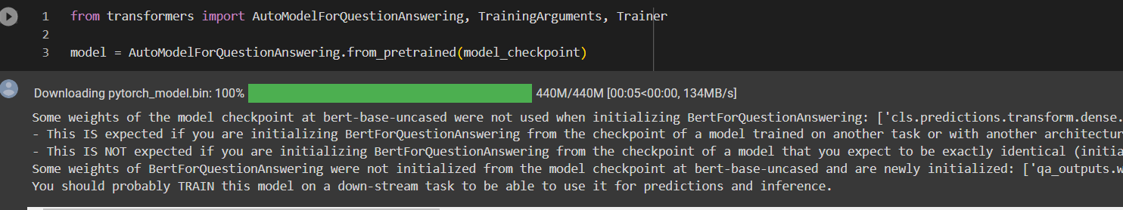
Train Reader
1. Download the pre-trained model and fine-tune it:
Warning throwing away some weights, the vocabulary transform, and vocabulary layer norm layers.
Randomly initializing some others, the pre-classifier and classifier layers.
we are removing the head used to pre-train the model on a masked language modeling objective and replacing it with a new head.
the library warns us we should fine-tune this model before using it for inference.

Slide 26
Train Reader
Initiate training Arguments: a class that contains all the attributes to customize the training.
if you want to save your model locally or push your model under an organization and not your namespace:
use the hub_model_id argument to set the repo name.
2. Data collator that will batch our processed examples together:
model_name = model_checkpoint.split("/")[-1]
args = TrainingArguments(
f"{model_name}-finetuned-squad",
evaluation_strategy = "epoch",
learning_rate=2e-5,
per_device_train_batch_size=batch_size,
per_device_eval_batch_size=batch_size,
num_train_epochs=3,
weight_decay=0.01,
push_to_hub=True,
)
from transformers import default_data_collator
data_collator = default_data_collator

Slide 27
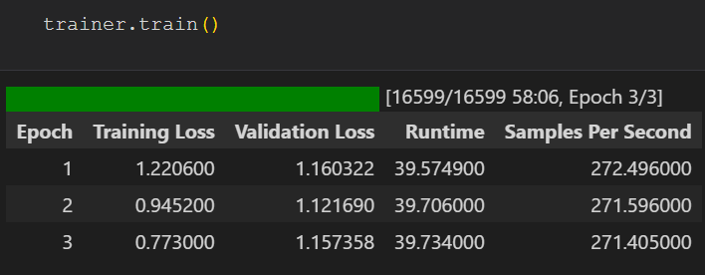
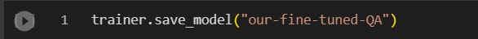
Train Reader
3. Initialize the Trainer:
4. Finetune our model:
4. Save the trained model locally:
trainer = Trainer(
model,
args,
train_dataset=tokenized_datasets["train"],
eval_dataset=tokenized_datasets["validation"],
data_collator=data_collator,
tokenizer=tokenizer,
)

Slide 28
Homework assignment
Evaluation of your new fine-tuned model
The code of evaluation in the Reader QA notebook you should go through it step by step.

Slide 29
References
The Haystack Dense Retriever Passages training notebook.
Hugging face question answering on Squad notebook.

Slide 30


